Slide 1
Elizabeth O’Mahoney
11:300:336
Professor Reagan
December 6th, 2017

Slide 2
New Brunswick’s Youth
New Brunswick’s children have high rates of overweight and obesity.
Keep in mind:
A large portion (64%) of New Brunswick’s demographic is Hispanic
New Brunswick is a low-income neighborhood
Lloyd, Kristen , et al. The Robert Wood Johnson Foundation

Slide 3
New Brunswick’s Youth
Healthy People 2020 suggests that people consume vegetables at least 3 times a day.
In New Brunswick:
12% of children meet this suggestion
24% of children eat vegetables lass than one time per day.
Lloyd, Kristen , et al. The Robert Wood Johnson Foundation

Slide 4
New Brunswick’s Youth
53% of children in New Brunswick do not eat fruits and vegetables as snacks daily (58% Hispanic children)
87% of New Brunswick parents agree that, in general, their child eats healthy!
Lloyd, Kristen , et al. The Robert Wood Johnson Foundation

Slide 5
Why is this happening?
Primarily Bodegas
3-4 aisles with limited supply of food (canned, bread, meats, small section dedicated to fresh fruits and vegetables)
Low-Income
New Brunswick is a low-income neighborhood with a very diverse, mostly immigrant population
Households cannot afford transportation to high end grocery stores (Bravo or Super Fresh), cannot afford the fresh fruits and vegetables, do not have the means to store these items (no refrigeration or cookware)

Slide 7
Our Mission
To provide youth with the opportunity to expand their knowledge on nutrition and wellness, and to allow them to take ownership of an asset within the community.

Slide 8
Our Goals & Objectives
Provide
Provide youth with partnerships within the community
GB will provide all participating youth with mentors.
GB will organize 80% of participating youth together to form stronger leadership skills including: communication, organization, and decision-making skills.
50% of the youth will confirm that GB has helped them relate more to their peers and community after 6 months of being in the program.
Teach
Teach the youth about healthier options in their daily lives
65% of youth will choose the healthier option during meal times.
45% of youth will be able to identify ways to eat healthier outside of the home.
60% of youth will be able to create meals that are healthy alternatives to foods they already enjoy.
Create
Create an accessible community garden, overseen by the youth
Youth will be able to improve their management skills through determining the plan/design of the garden and the plants, time management of activities in the garden, and working together to secure the level of success of the garden.
90% of the youth will be able to solve typical issues when gardening. These issues include pest control, dying plants, soil nutritional content, and sun/water exposure and will be measured by “Youth Supervisor” instructor in the garden.
90% of the youth will develop planning, planting, staking, weeding, watering, harvesting, and caring skills in the garden. This will be measured by obtaining sample plans, short responses, and group activities.
Increase
Increase the sustainability of food in the community
The garden will provide seasonal fruits and vegetables to participants, and for purchase to the community in the youth-run Market.
At least 50% of the youth will be able to utilize sustainable gardening techniques.
50% of the youth will be able to organize the garden to make it more sustainable.
Offer
Offer a safe, educational environment for the youth of New Brunswick
GB will reduce the number of youth who are described as “latch-key kids” in New Brunswick by 5% in one year.
65% of participating youth will return after their first year to continue learning.
75% of the participating youth will have higher knowledge on health and gardening after a year; evidence provided by a short pre- and post- program questionnaire.

Slide 9
Our Organization
Board of Trustees
Executive Director
Accounting Manager
Youth Program Supervisor
Fundraising Coordinator
Educators
Garden Manager
Community Market Manager
Market Assistant
Membership & Donations Coordinator
Membership Management
Community Outreach & Partner Supervisor
Community Specialist
Partnership Specialist
Human Resources Manager
Volunteer Manager
Organizational Specialist

Slide 10
Board of Trustees
Nutritionist: BA in nutrition, community nutrition, or dietetics. Can aid in health and wellness aspect of mission.
Bank President: business savvy, access to funds, understands the business side to the non-profit.
Educator: New Brunswick teacher/professor who can help create and manage the curriculum as well as have a presence in school systems and surrounding colleges.
Community Committee Member: Known community member of New Brunswick, relates to the community at a large scale and can give insight on what the community lacks, needs, and favors.
Youth Development Specialist: at least a BA in youth development, child psychology, or related field, and experience in youth programs.

Slide 11
What We Do
Afterschool Program offered Monday through Thursday from 3-7pm, and Saturday 9am-1pm.
Operate as a Community Market/Garden
We offer four main programs for children from ages 5-18 years old
TurnUp
RakeItUp
OnTheMARKet
CookingThyme
This Photo by Unknown Author is licensed under CC BY-NC-ND

Slide 12
Where We Are
The Market: 276 George St. New Brunswick, NJ 08901
Leasing
As of right now this is our main/office location – looking to expand next year
The Garden: New Brunswick Farmers’ Market Garden
Until we have the funds to purchase our own plot of land/building that can be our main facility
The Classes: New Brunswick Middle School, RWJ Fitness & Wellness

Slide 13
Our Programs
TurnUP
RakeItUP
Ages 5-18 Health Program
Focus on health and wellness
Fruits
Vegetables
Healthy Alternatives at school & home
Community resource involvement (trips to grocery stores and farms)
Ages 5-18 Gardening Program
Focus on GB Garden
Learning about seasonal fruits & vegetables
How to grow and take care of them
Building gardening skills
Problem solving skills

Slide 14
Our Programs
OnTheMARKet
CookingThyme
Ages 15-18 Professional Program
Focus on building work-related skills
Cashiering
Leadership skills
Team building skills
Management skills
Problem Solving
Ages 10-18 Cooking Program
Focus on Healthy Cooking
Creating healthy recipes
Finding better substitutions
Cooking at home

Slide 15
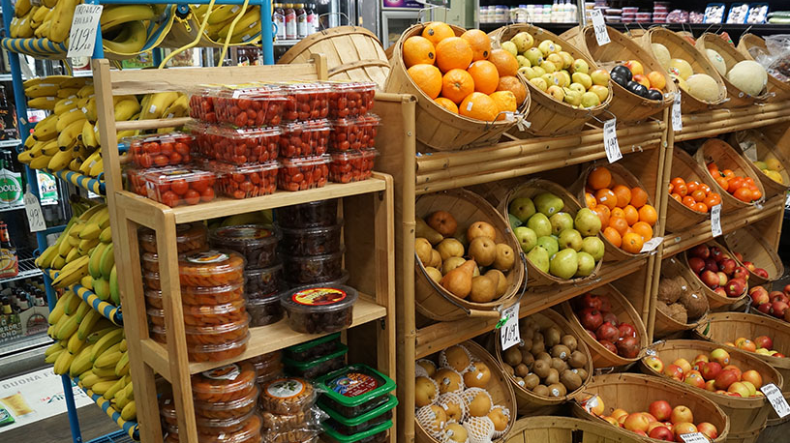
The Community Market
Where OnTheMARKet takes place
One of our main sources of income and community presence
Open to the public: Fridays (3pm-6pm) and Saturdays (9am-1pm)
Holds community meetings and educational classes here
Accepts EBT/SNAP
GB Members get coupons for the market through our monthly newsletter

Slide 16
SWOT Analysis
WOT Analysis:
Strengths | Weaknesses | Opportunities | Threats
Bridge between community, youth, and health | Poor fundraising | Partnerships, find other ways to raise funds | Debt
Valuable/positive services for the community | Community trust | Getting to know the community | Competing programs in the area for garden
Strong program for youth who are interested in health and wellness | Facility utilized for garden | Trade offs for land | Insecure facility
Multiple ways to get involved the community | Small volunteer base | Look for other ways to find volunteers | Hard to keep volunteers coming back
Young, fresh look onto this issue and how to fix it | Gaining momentum | Becoming an active role in the community | Youth interest
Program during after school/work | Large start-up costs | Partnerships with schools
Knowledgeable staff base | Low-income community | Partnerships with police/fire departments
Large need for wellness/nutrition education in Newark | Location | Rutgers Students/Co-op
Relationship with local schools |  | Partnership with RWJ

Slide 17
Assets in New Brunswick
Rutgers University
1
Cooperative Extension: 4-H Youth Development, free/minimal charge, provides education, relationship with community and farmers
Robert Wood Johnson
2
Largest health care facility in the area and already provide a lot of health education services to New Brunswick (Wellness Cooking, but nothing aimed at health of children)
Community Farmer’s Market
3
Community garden, but not focused on children
They support other gardening efforts across New Brunswick – large ally!
Buy a plot until we purchase land

Slide 18
Our Volunteers
Mostly Rutgers or neighboring high school students
Can qualify for to be Educators or Market Assistants
Older, more qualified personnel can become any position in our company
We train all volunteers and require continuous training throughout the year
Volunteer retention rates are kept high by writing letters of recommendation, Community Market coupons, and offering to be a site for educational credits

Slide 19
Our Budget: An Overview
Projected Income = $836,456.00
Projected Expenses = $832,024.00
Total Excess = $4,432.00
Goes into funding for prospective facility/plot of land for expansion of programs for our youth ☺

Slide 20
Our Budget: Projected Income

Slide 21
The Budget: Itemized Expenses
Employee Personnel Costs
Position | Salary | Fringe benefits (38%) | NJ Unemployment (2.68%) | NJ Disability (.50%) | NJ Workforce Training Fund (.10%) | Social Secruity (6.25%) | Medicare (1.45%) | Workman's Compensation (3%) |  | Yearly Total of Personnel Costs
Executive Director | $ 75,000.00 | $ 28,500.00 | $ 2,010.00 | $ 375.00 | $ 75.00 | $ 4,687.50 | $ 1,087.50 | $ 2,250.00 |  | $ 38,985.00
Fundraising Coordinator | $ 51,800.00 | $ 19,684.00 | $ 1,388.24 | $ 259.00 | $ 51.80 | $ 3,237.50 | $ 751.10 | $ 1,554.00 |  | $ 26,925.64
Community Outreach & Partnership Supervisor | $ 45,400.00 | $ 17,252.00 | $ 1,216.72 | $ 227.00 | $ 45.40 | $ 2,837.50 | $ 658.30 | $ 1,362.00 |  | $ 23,598.92
Human Resource Manager | $ 60,000.00 | $ 22,800.00 | $ 1,608.00 | $ 300.00 | $ 60.00 | $ 3,750.00 | $ 870.00 | $ 1,800.00 |  | $ 31,188.00
Organizational Specialist | $ 55,000.00 | $ 20,900.00 | $ 1,474.00 | $ 275.00 | $ 55.00 | $ 3,437.50 | $ 797.50 | $ 1,650.00 |  | $ 28,589.00
Volunteer Manager | $ 45,000.00 | $ 17,100.00 | $ 1,206.00 | $ 225.00 | $ 45.00 | $ 2,812.50 | $ 652.50 | $ 1,350.00 |  | $ 23,391.00
Full Time Payroll Total: | $332,200.00 |  |  |  |  |  |  |  | Total: | $172,677.56
Position | Hourly Wage | Hours/Week | Salary | # Employees | Total Position Salary
Youth Program Supervisor | $ 22.00 | 20 | $ 22,880.00 | 1 | $ 22,880.00
Accounting Manager | $ 25.00 | 20 | $ 26,000.00 | 1 | $ 26,000.00
Educators | $ 12.00 | 15 | $ 9,360.00 | 10 | $ 93,600.00
Garden Manager | $ 16.00 | 20 | $ 16,640.00 | 1 | $ 16,640.00
Community Market Manager | $ 16.00 | 25 | $ 20,800.00 | 1 | $ 20,800.00
Membership & Donations Coordinator | $ 18.00 | 20 | $ 18,720.00 | 1 | $ 18,720.00
Market Assistant | $ 11.00 | 20 | $ 11,440.00 | 3 | $ 34,320.00
Membership Manager | $ 18.00 | 30 | $ 28,080.00 | 1 | $ 28,080.00
Community Specialist | $ 18.00 | 30 | $ 28,080.00 | 1 | $ 28,080.00
Part-Time Payroll Total: | $289,120.00
Total Yearly Payroll: | $621,320.00

Slide 22
Our Budget: Projected Expenses
Salaries Full Time

Slide 23
Prospective Grants
Government
HHS-2018-ACF-ACYF-YO-1353 Street Outreach Program $200,000
PA-14-176 Healthy Habits: Timing for Developing Sustainable Healthy Behaviors in Children and Adolescents (R21) $200,000
PA-14-142 Community Partnerships to Advance Research (CPAR) (R01) $5,000
Federal
Robert Wood Johnson Foundation's New Jersey Health Initiatives $200,000
Grants to USA K-12 Schools and Nonprofits for Educational Edible Garden Projects $2,000
Grants to USA and Territories Nonprofits for Programs that Aim to Prevent and Reduce Type 2 Diabetes and Hypertension $60,000

Slide 24
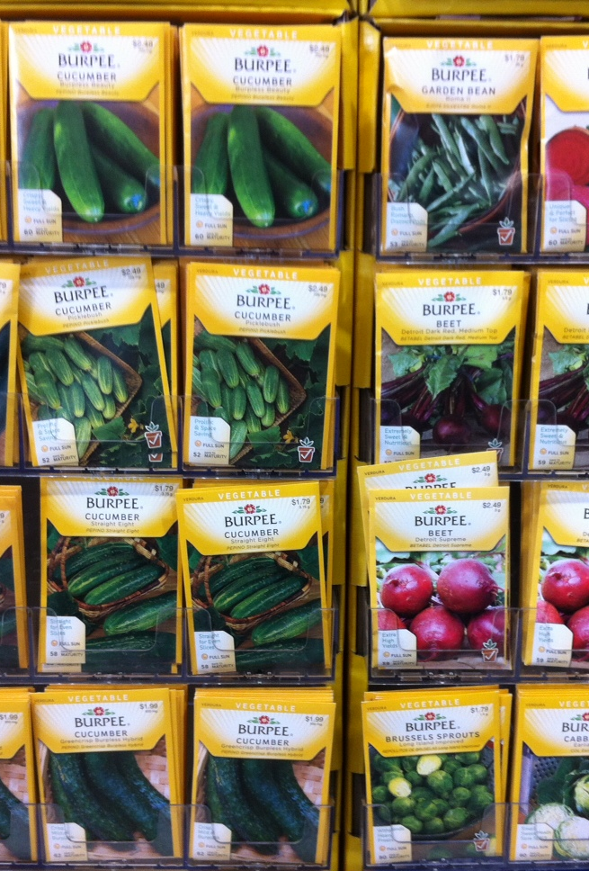
Fundraising: On-going
On-going fundraising will include selling seeds fundraising. Seeds fundraising is low cost as many businesses offer free flyers and fill-out forms. Terroir Seeds lets you keep 50% of the profit you sell. If we apply the 1% population participation, we can expect 8,374 orders totaling to $4,187.00 in sales annually from this fundraiser.
Bi-annually we will hold a silent basket auction at our facility. These events are very low cost, you just buy tickets for people to buy. Baskets of all different types are donated from our directors, employees, volunteers, families, and community and they are put up for auction. People can purchase tickets and place the ticket in a bowl next to the basket they would like to win and the basket it raffled off at the end of the night. If tickets cost $10 for 12 tickets, we can predict 500 people participating (for one event). We can expect $10,000.00 for these biannual events yearly.
With around 23 employees we can expect $250 from each employee which is equal to $5,575.00 annually.
This Photo by Unknown Author is licensed under CC BY-SA

Slide 25
Fundraising: Special Event
GB’s Work-a-thon! One Saturday, every July members of the community and those immediately surrounding can participant in our work-a-thon by buying a service for one of our youth and organizational volunteers to do.
We expect over 1% participation from the Middlesex County community which is roughly 8,374 participants. If this population is distributed evenly among the services we offer, that means 837 people will participate in each service and the total net for the event would be $156,519.00.

Slide 26
GrowBrunswick: The Future
After achieving the goals and objectives stated earlier GB plans on expanding:
+1 location in a neighboring city, most likely North Brunswick or Franklin
Reaching more children in more schools
Having stronger relationships with farmers and the community
Retaining more volunteers than years’ past

Slide 27
GrowBrunswick: Final Thoughts
Community health starts with our children
New Brunswick needs to start to focus on them and see how big of an asset they are to the community
GrowBrunswick utilizes health and wellness to empower children to make better choices in their life.
Any questions, comments, or concerns?

Slide 28
Citations
Lloyd, Kristen , et al. The Robert Wood Johnson Foundation, www.cshp.rutgers.edu/downloads/8660.pdf.

